Slide 1


Slide 2
Objective of Lecture
Explain the maximum power transfer theorem.
  Chapter 4.8 Fundamentals of Electric Circuits

Slide 3
Maximum Power Transfer
For any power source, the maximum power transferred from the power source to the load is when the resistance of the load R_{L} is equal to the equivalent or input resistance of the power source (R_{in} = R_{Th} or R_{N}).
  The process used to make R_{L} = R_{in} is called impedance matching.

Slide 4
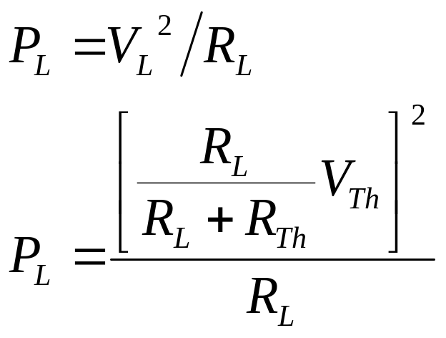
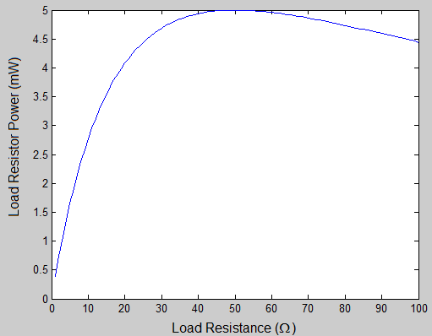
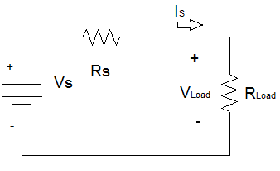
Power Transfer Calculation
R_{Th} 50Ω
V_{Th}
1V

Slide 5
Application
When developing new circuits for a known application, optimize the power transfer by designing the circuit to have an input resistance close to the load resistance.
When selecting a source to power a circuit, one of the selection criteria is to match the input impedance to the load resistance.

Slide 6
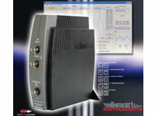
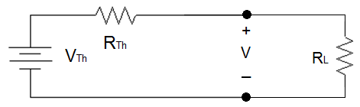
Example Seen in ECE Labs
    Function generator on the Velleman oscilloscope that is used in a number of ECE lab classes. Measurements of V, the voltage across the load resistor R_{L}, can be well below the voltage specified on the function generator.
      R_{in} = R_{Th} = 40Ω
      This is observed as R_{L} approaches or
      smaller than R_{Th}.
http://www.vellemanusa.com

Slide 7
Other Examples
Selection of wire –
  Antenna wire is designed to match a 75 Ω load.
  Coaxial cable is designed to act like a 50 Ω load.
Most electronic and electrical equipment are designed to have an R_{Th} of 50 Ω.
  The speakers used in some of the ECE labs are designed to act like an an 8 Ω load while microphones are designed to act like a 600 Ω load.
    It is important that the resistance of the wire that runs to the speaker is very low or the power will be dissipated in the wire rather than used to create sound.
    For best audio quality, the input impedance of the circuit connected to the speaker (or the microphone) should be equal to the resistance of the speaker (or the microphone).

Slide 8
Summary
Maximum power transfer theorem is used frequently to insure that the greatest power can be transferred from a power source to a load.

